Slide 1

Economic development strategy of the Tampere city region
Facing the Future 2026–2030

Slide 2
Contents
Joint strategy for the city region
Facing the Future in two minutes
Strategy vision
The five objectives of the strategy map
Strategic goals and
development focal points
Strategy vision
Performance indicators

Slide 3
Strategy in 2 minutes video on web page:
https://businesstampere.com/en/the-ecocomic-development-strategy-of-the-tampere-region/
Notes:
Video by Marker Wizards

Slide 4
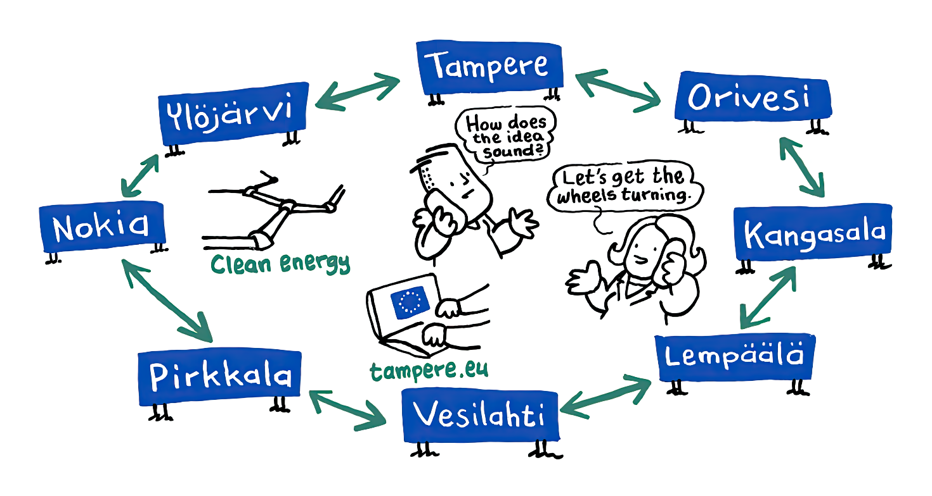
Joint strategy
Defines the joint strategic guidelines for actors promoting and enabling economic activity
in the economic area formed by Kangasala, Lempäälä, Nokia, Orivesi, Pirkkala, Tampere,
Vesilahti, and Ylöjärvi until 2030.
In line with key regional and national strategies
A network strategy that is translated into action in the daily work of key players, strategy updates, annual plan guidelines, and service agreements.

Slide 5

More details about the business strategy
can be found by scanning this QR code.
https://businesstampere.com/
tampereen-kaupunkiseudun-elinkeinostrategia/
Facing the Future

Slide 6
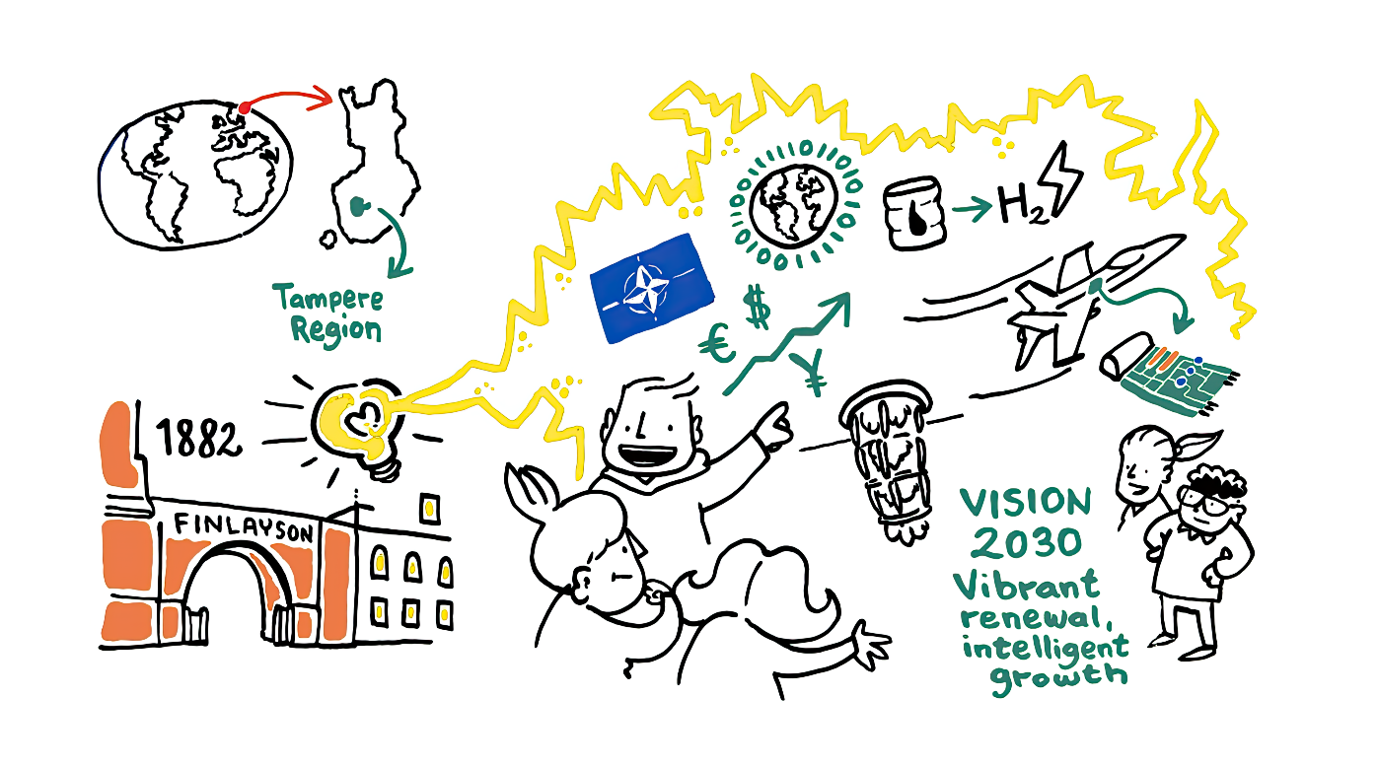
Vision: Vibrant renewal, intelligent growth
Expresses the shared development goals of actors promoting and enabling economic activity in the city region until 2030.
A target state that appeals to a wide range of business operators and the entire region
Vibrant renewal places continuous development support and strengthening renewal capabilities alongside innovation and technology focus.
Alongside strong technological leaders, extensive renewal is needed and it should be achieved in small steps
Intelligent growth is also responsible growth, not just accelerated growth.
“In Finland, Tampere is the best place to be and live. How can we maintain it so that we at least do not lose that drive? Recognize areas of success and be bold in your investments. It pays off when you have the mentality of success. It requires courage.”
Notes:
the joint development goals of the actors for 2030.
The vision was chosen at the kick-off event in a public vote involving around 200 participants. However, during the joint seminar, it was decided to change the vision's strong focus on innovation and growth. Instead of developing innovations, the emphasis was placed on broader renewal capabilities; instead of accelerating growth, the emphasis was placed on smart growth that takes responsibility into account.
Vibrant renewal reflects a strong focus on innovation and technology, alongside support for continuous development and strengthening of renewal capabilities. Alongside strong technological leaders, extensive renewal is needed and it should be achieved in small steps
Intelligent growth is also responsible growth.
The vision is promoted through objectives.
The development focal points are examples of sets of measures that promote the achievement of strategic goals through collaboration between business operators.

Slide 7
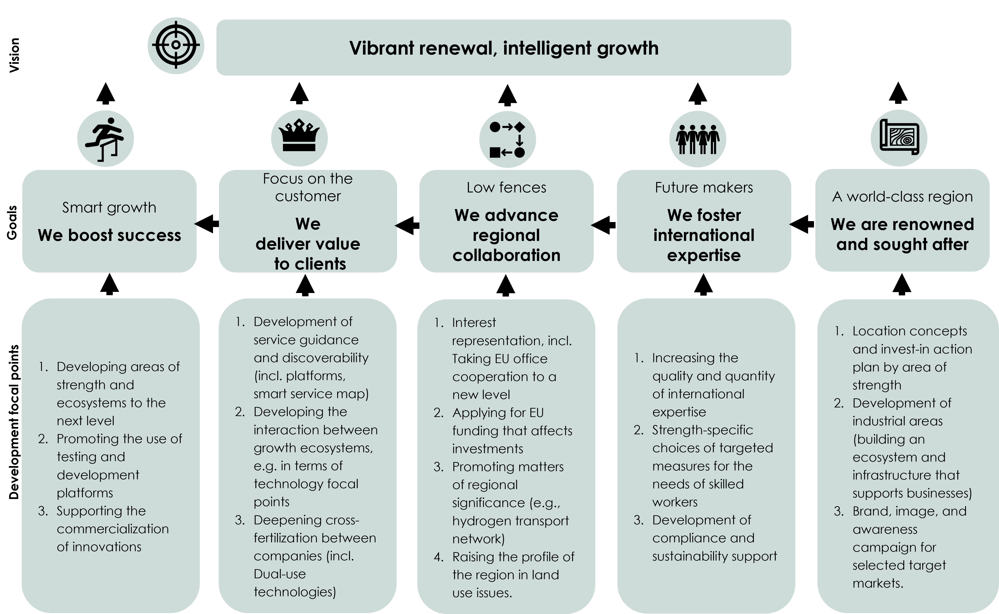
Strategy map

Slide 8
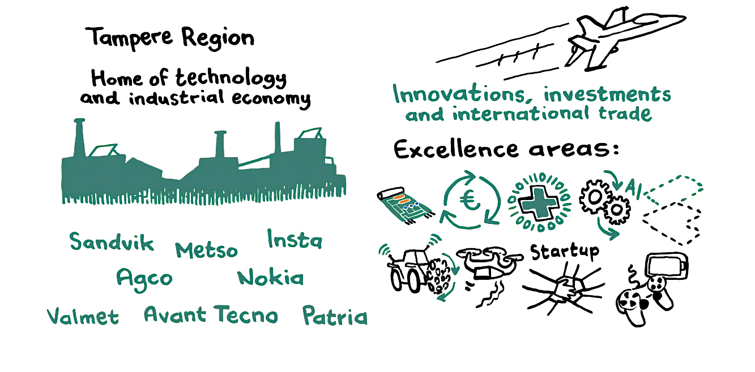
We boost success
The goal is to attract and take advantage of new opportunities while supporting current success and growth.
The focus is both on accelerating the success of companies already operating in the region and on attracting new growth drivers and companies to the region.
Concrete development focal points include, for example,
  developing areas of strength and ecosystems to the next level
  promoting the use of testing and development platforms
  supporting the commercialization of innovations.
“Promoting growth is not just about developing new innovations. Especially for small and medium-sized enterprises, it also means promoting internationalization and seeking new markets abroad.”
Notes:
The goal is to attract and take advantage of new opportunities while supporting current success and growth.
The focus is both on accelerating the success of companies already operating in the region and on attracting new growth drivers and companies to the region.
Means of achieving intelligent growth include promoting technological focal points, critical breakthrough technologies and commercializable innovations. It is also essential to promote megatrends, the green transition, and the opportunities offered by artificial intelligence, as well as to support the acquisition of financing.
There are already clusters with turnovers in the billions; in addition, there are smaller sectors with significant economic potential.

Slide 9

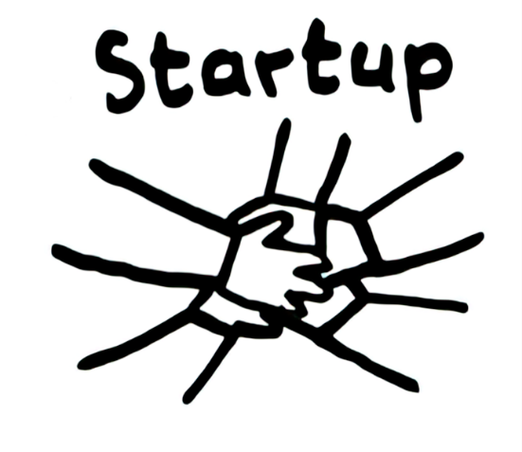

Drivers of intelligent growth
The focus is on the new wave of manufacturing, but smaller sectors with significant potential, such as digital health solutions, have also been identified.
The Tampere region has more than a dozen open and active business and innovation ecosystems and R&D units.
Strong areas in the technology industry include smart machines and automation, as well as imaging in terms of applications.
Technological expertise in areas such as embedded systems, laser technologies, chip design, and a wide range of defence industry applications, social security solutions, and cyber security.
The fragmentation of manufacturing due to geopolitics, electrification, and the global strengthening of defence capabilities require the construction of new manufacturing units. Examples of this include the pilot line for semiconductor chip packaging, the chip competence centre, and new industrial-scale investments in the hydrogen economy.

Slide 10
Medical devices
Digital health
& IT
Chips & Photonics
Biotechnology & Pharma
Cyber security
Health Tech
Comprehensive Security
Software Engineering
Civil Security
Health & Wellbeing
Military solutions
Defence technology
Artificial Intelligence
Dual-use technology
Digital industry
Safety &
Security
Camera & Imaging tech
Cleantech
Green materials
Creative solutions
Circular economy
Creative
Economy
Intelligent machines
Sustainable Technology
Green energy
Alternative fuels
& H2
Metaverse
Autonomous operation
Energy storage
Industry 4.0
Smart grid
Productions & IPR
Connectivity
Sensors
& IoT
High-mix low-volume (HMLV) manufacturing
Simulations
& digital twins
Batteries and Electromobility
System design & intelligent solutions
Machine vision
& control
Factory automation

Slide 11
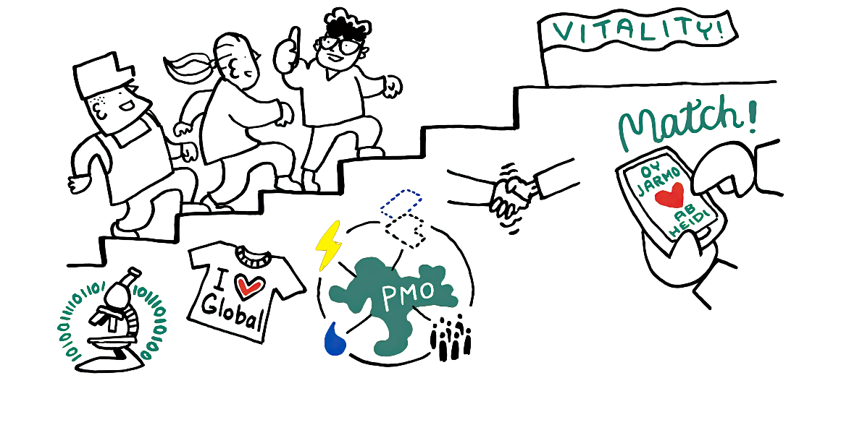
We deliver value to clients
Developing and producing effective, value-generating business services through extensive regional collaboration
Key measures: impressive regional service package and smart, needs-based service guidance
Development focal points include
  development of service guidance and discoverability
  developing the interaction between growth ecosystems, e.g. in terms of technology focal points
  deepening cross-fertilization between companies
“We are able to serve those who are already here and create opportunities for newcomers to succeed and grow. This is the most important thing. We provide better service than anywhere else, and this is evident and tangible in the lives of companies. We will do everything we can to remove obstacles at the municipal level, for example.”
Notes:
The objective includes the development and provision of effective, value-generating business services through extensive regional cooperation.
At the heart of the range of services is an impressive regional service package and intelligent, needs-based service guidance.
Future business services will be strongly data-driven.
The region's business services cover everything from starting a business to achieving international success.
Research, development, innovation, and testing environments provide the conditions for developing solutions that generate growth.
Ensuring growth requires supporting a diverse economic structure and promoting business opportunities on a broad scale.

Slide 12

We advance regional collaboration
Strong regional cooperation must be nurtured and further developed; it enables value-generating business services and accelerates the growth of economic activity.
Development focal points include
  interest representation, incl. taking EU office cooperation to a new level
  applying for EU funding that affects investments
  promoting regionally significant issues, such as the hydrogen transport network
  raising the profile of the region in land use issues.
“Regional collaboration requires a common goal, but a little competition does wonders. Large-scale cooperation projects, such as major green transition initiatives, should be undertaken jointly.”
Notes:
Strong regional collaboration must be nurtured and further developed. Promoting regional collaboration enables value-generating business services and accelerates the growth of economic activity.
Promoting regional collaboration, smooth processes, and common rules is essential.
Promoting collaboration between regions and benchmarking support the maintenance of a pioneering position, also on an international level.
It is important to engage stakeholders, engage in joint proactive advocacy, develop structures, and take advantage of their potential. A new focus in cooperation is promoting preparedness in business and industry.

Slide 13
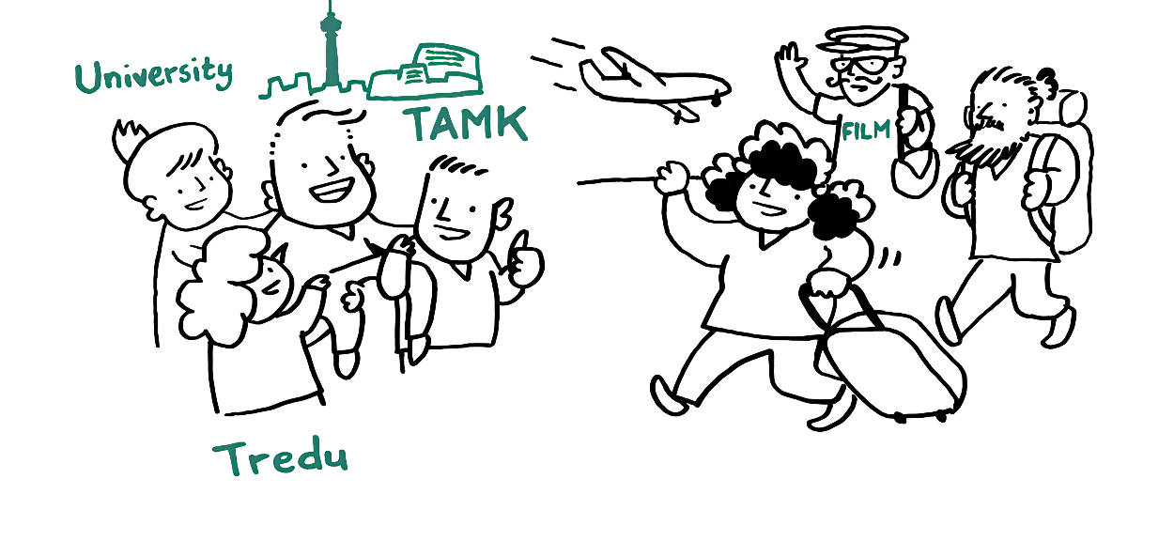
We foster international expertise
The goal emphasizes the need to ensure future expertise.
The aim is to increase the number of jobs in the city region and to ensure that education and skills meet the needs of the labour market.
Development focal points include
  increasing the quality and quantity of international expertise
  strength-based selections of targeted measures to meet the needs of skilled workers
  development of compliance support and sustainable development support.
“The unemployment rate in Tampere is currently over 13 percent. The need for skilled labour in companies must also be met by employing the unemployed who are already here.”
Notes:
The objective emphasizes the need to ensure future expertise. The focus is not only on attracting and retaining international talent, but also on increasing the receptiveness of companies.
The number of international workers who generate innovation will also increase; investing in the innovation ecosystem will ensure intelligent growth.
Anticipating future skill needs and providing training that meets the needs of working life will ensure the success of future generations. It is also important to nurture the appeal of the region's leading industries.
The aim is to increase the number of jobs in the city region and to ensure that education and skills meet the needs of the labour market.

Slide 14
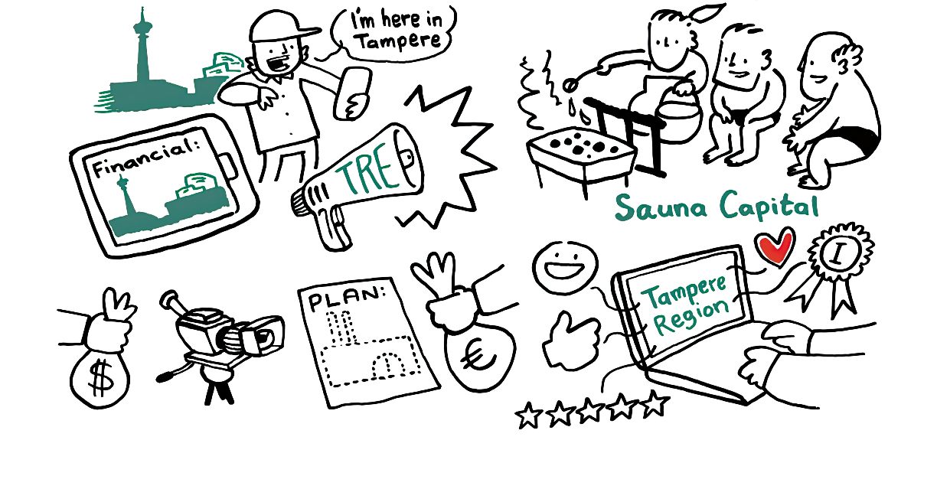
We are renowned and sought after
Focus on developing Finland's most attractive business area and operating environment
We are Finland's most desirable place to live; we also want to profile ourselves as the primary choice for business in the eyes of companies.
Development focal points include
  location concepts and action plan for promoting investment by area of strength
  development of industrial areas (building an ecosystem and infrastructure that supports businesses)
  brand, image, and awareness campaign for selected target markets.
“Soft pull factors are important and come across well – a world-class city on a human scale.”
Notes:
Its own niche – From a business perspective, a visible and desirable region does not just happen “on the side”; special effort must be made to achieve it.
The objective focuses on developing Finland's most attractive business area and operating environment. We are Finland's most desirable place to live; we also want to profile ourselves as the primary choice for business in the eyes of companies.
A visible and desirable region creates the foundation for achieving other goals. However, a world-class region cannot be built by developing just one aspect, which is why the range of measures includes a wide spectrum of issues that are critical not only from the perspective of business, but also from the perspective of living and "enchanting everyday life."
We are already world class in soft dimensions. Safety, accessibility, and image are key factors in the region's appeal and retention power. Promoting responsibility and well-being, urban development, and location concepts play an important role.

Slide 15
